Slide 1
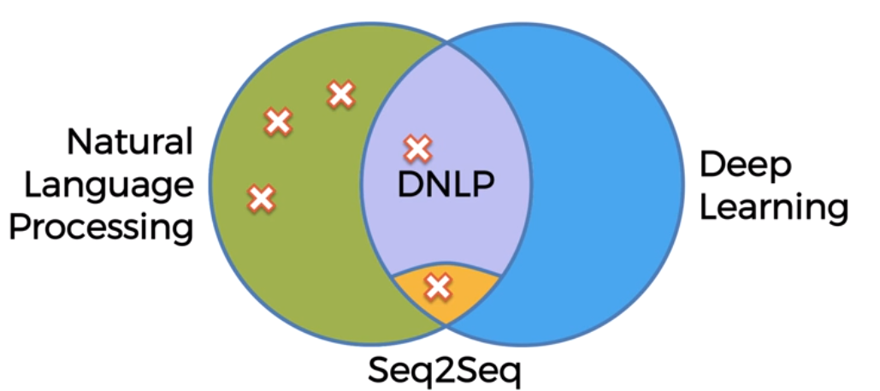
NLP-Natural Language Processing

Slide 2
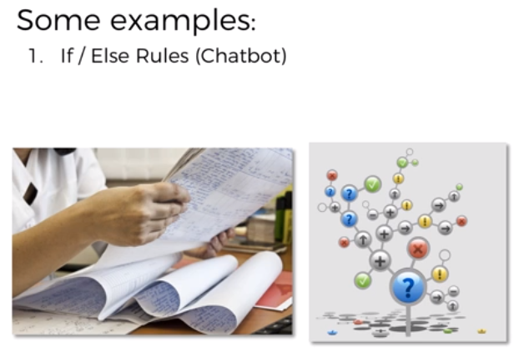
NLP-Natural Language Processing
This is a way that we used to create chatbots back in the day. So if/else rules are located over here on our diagram in just the NLP part, and what they entail is a huge list of possible questions and answers to those questions.
So once somebody in the chat asks a question, or we can identify that part of the sentence is the question that we have pre-recorded, then we will give them the correct answer, the answer that is associated with that question. But as you can imagine, such a mechanical approach to answering questions or chatting with people does not result in anything humanlike, anything realistic.
But people want something tailored to them, something specific, they're asking about something else, but doesn't fit into that list of questions and answers. And it just very quickly becomes a mess.

Slide 3
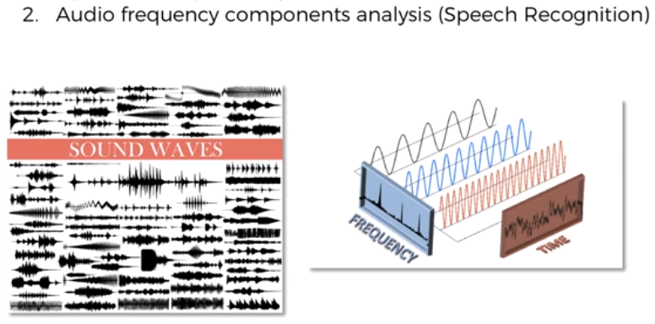
NLP-Natural Language Processing
A very general overview of what happens. We look at the frequencies, certain mathematical operations and we're not doing any neural computations or not creating any neural networks. We're just doing mathematical calculations
around the frequencies that we can observe, comparing them to the mathematical calculations we have in our library of pre-analyzed frequencies. And then we are matching it up. We're finding what word a person is saying, what question they're asking or what the sentence is meaning. And then that is how we recognize speech.

Slide 4
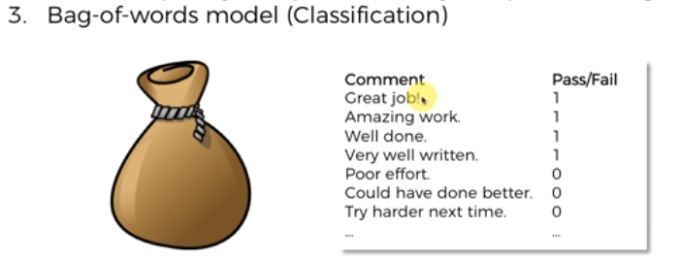
NLP-Natural Language Processing
It'll look at the words and try to classify these words or associate these words with either positive results or a negative result in our case. And so in this case, like amazing would be most likely associated with positive view. But then these other words like poor or harder would be associated with zeros. So then it'll remember and keep these words in a bag and next time something comes up, for instance, somebody says good, good job, keep, keep it up or something like that, it will analyze the words that are in that new sentence by pulling them out of the bag and looking at them and understanding are they mostly associated ones or zeros? And then it'll be able to predict or classify the new comment, even without knowing what the mark was, pass or fail.

Slide 5
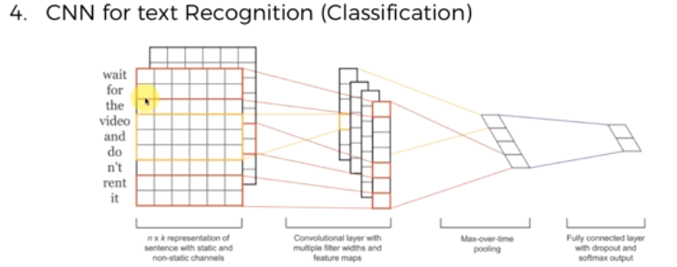
NLP-Natural Language Processing
It's called convolutional neural networks for text recognition then further for classification, which is indeed a deep natural language process model. It's a neural network that is used for mostly image recognition for like videos, self-driving cars use them to detect obstacles on roads, people and so on. So mostly it's used for image processing or video processing. The way it works is, these words are transformed into a matrix and that's done through an operation called embedding of words and once they're in a matrix, the same principles as were applied for images in convolutional neural networks, are applied. There's a convolution operation going through these images. Then they're pooled, max pooled or min pooled or sum pooled, and then they're flattened and we have the prediction. It’s just an overview

Slide 6
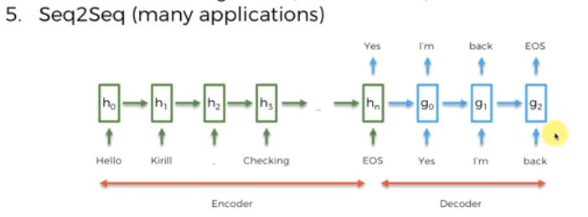
NLP-Natural Language Processing
Each word that you used to type was converted to its target language giving no regard to its grammar and sentence structure. Seq2seq revolutionized the process of translation by making use of deep learning. It not only takes the current word/input into account while translating but also its neighbourhood. Seq2Seq (Sequence-to-Sequence) is a type of model in machine learning that is used for tasks such as machine translation, text summarization, and image captioning. The model consists of two main components:
Encoder
Decoder
Seq2Seq models are trained using a dataset of input-output pairs, where the input is a sequence of tokens and the output is also a sequence of tokens. The model is trained to maximize the likelihood of the correct output sequence given the input sequence.

Slide 7
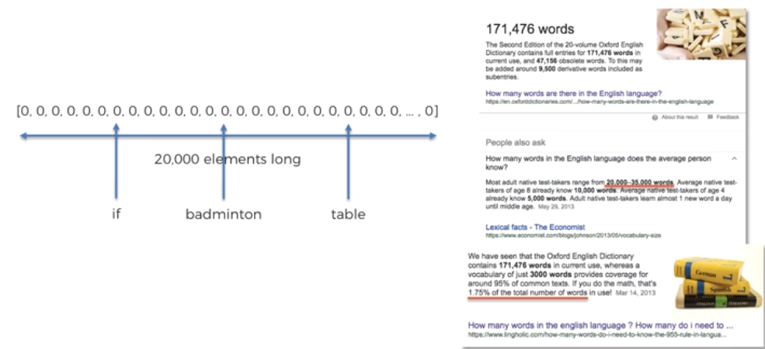
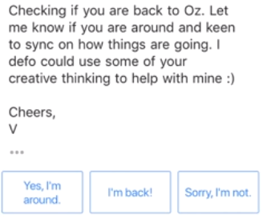
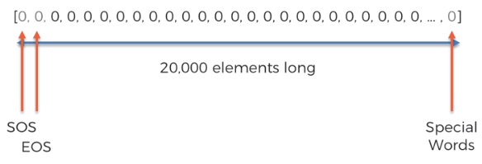
Bag Of Words

Slide 8
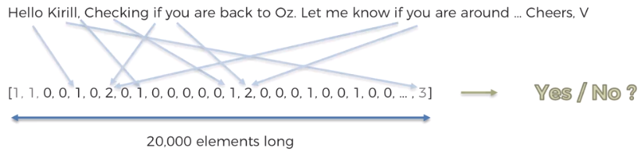
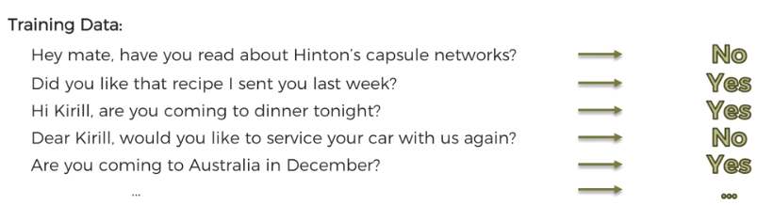
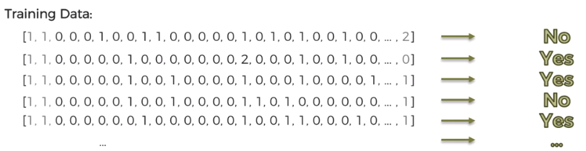
Bag Of Words

Slide 9
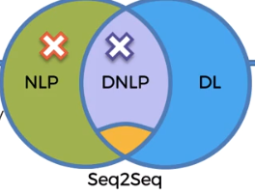
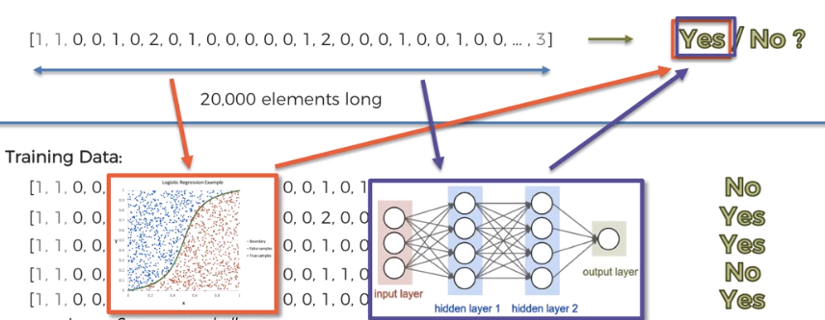

Bag Of Words

